Slide 1
Continuous Models for Scene and Traffic Participant Interactions in Road Scene Understanding
Vikas Dhiman
SUNY at Buffalo
Mentor : Manmohan Chandraker

Slide 2
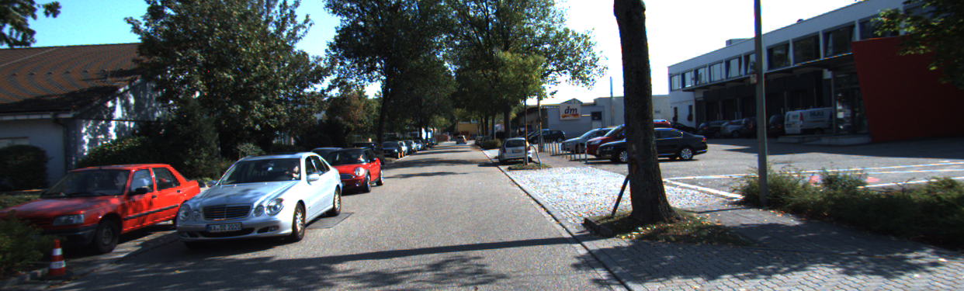
Monocular Road Scene Understanding

Slide 3
Monocular Road Scene Understanding
Object detection: Detect various traffic participants (TP)

Slide 4
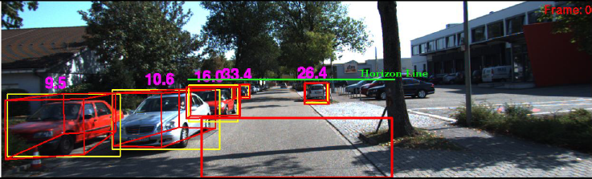
Monocular Road Scene Understanding
Object detection: Detect various traffic participants (TP)
Object localization: position and orientation of TPs in 3D

Slide 5
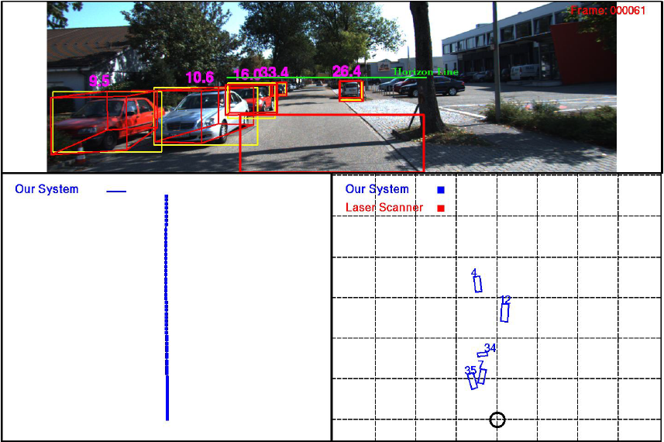
Monocular Road Scene Understanding
Notes:
Each TP distance is calculated quite well. However, their global relationships to the scene and to each other are inaccurate.
We wish to get more accurate overall scene representation, perhaps at the cost of sacrificing some localization accuracy.

Slide 6
Monocular Road Scene Understanding
Lane and Map
Information
Object detection: Detect various traffic participants (TP)
Object localization: position and orientation of TPs in 3D
Detect various scene elements (SE)

Slide 7
Monocular Road Scene Understanding
Object detection: Detect various traffic participants (TP)
Object localization: position and orientation of TPs in 3D
Detect various scene elements (SE)
Enforce relations between TPs and SEs

Slide 8
Monocular Road Scene Understanding
Object detection: Detect various traffic participants (TP)
Object localization: position and orientation of TPs in 3D
Detect various scene elements (SE)
Enforce relations between TPs and SEs
Enforce relations between TPs

Slide 9
Monocular Road Scene Understanding
Object detection: Detect various traffic participants (TP)
Object localization: position and orientation of TPs in 3D
Detect various scene elements (SE)
Enforce relations between TPs and SEs
Enforce relations between TPs
Spatially and temporally consistent relationships.

Slide 10
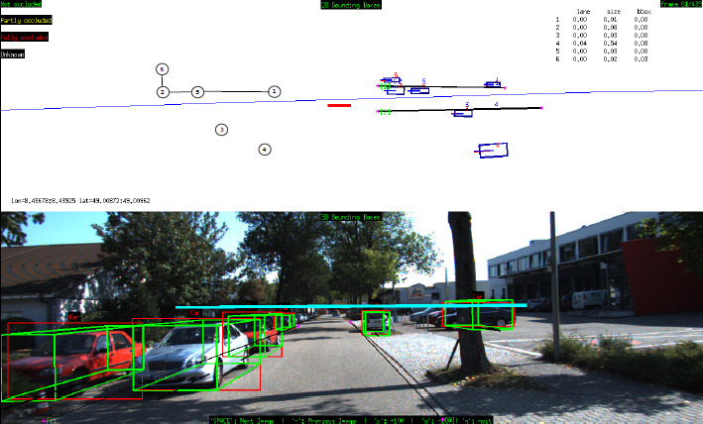
Monocular Road Scene Understanding

Slide 11
Relation to Overall Framework
Ground plane
Traffic participants
Scene elements
Detections
Point tracks

Slide 12
Relation to Overall Framework

Slide 13
Prior Works
Localize individual objects
[Wojek et al. 2013, Song and Chandraker 2014]
Cannot capture interactions
We model TP-Scene and TP-TP relationships
Use stereo
[Ess et al. 2011, Geiger et al. 2013]
Dense depth information available from stereo
We use a single camera (monocular)
Discontinuous occlusion modeling
[Zia et al. 2014]
Harder optimization, unpredictable output
We develop continuous occlusion models, which yields probabilistically meaningful interactions.

Slide 14
Input-Output
Inputs:
Camera poses and ground plane from SFM
2D object detection
Feature tracks on objects
GPS
Outputs:
3D object bounding boxes
Consistent TP-Scene relations
How objects relate to lane geometry
Consistent TP-TP relations
Occlusion relationships between objects
Which point belongs to which object.

Slide 15
Bounding Box Energy
Simpler version without occlusion
Uses prior size, contact of 2D bounding box with ground.
….
….
….

Slide 16
3D Points Energy
Simpler version without occlusion
Backproject a point at time t-1 to 3D bounding box
Compute reprojection error with observation at time t.

Slide 17
Bird-Eye View
Use SFM camera pose and ground plane to represent each TP in BEV.
BEV Transform

Slide 18
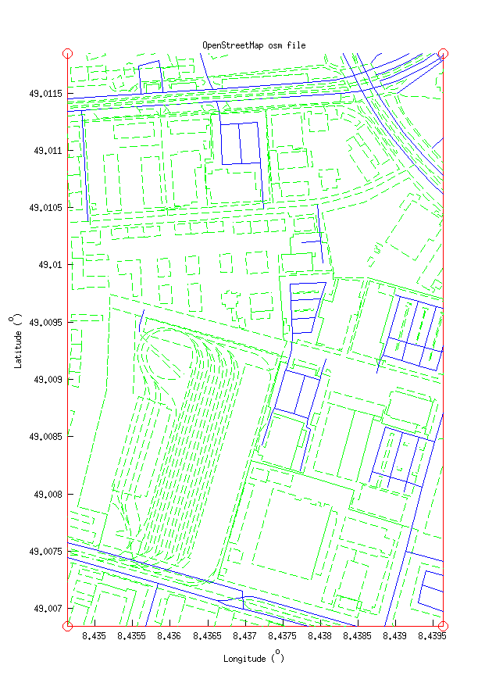
Extracting Scene Elements
Use OpenStreetMaps to extract lane geometry
Use GPS coordinates
Automatically filter out small lanes and side streets
Annotated lanes (to be replaced by lane detector)
Align SFM poses with lane geometry.

Slide 19
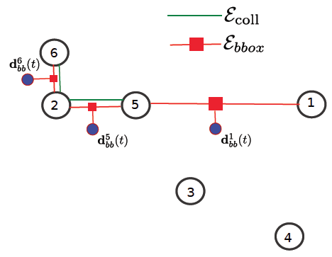
TP-Scene Constraints
Lane position and orientation
filter away far objects
align objects with closest lane directions.
Energy for 1 lane:
Soft energy for closest lanes:

Slide 20
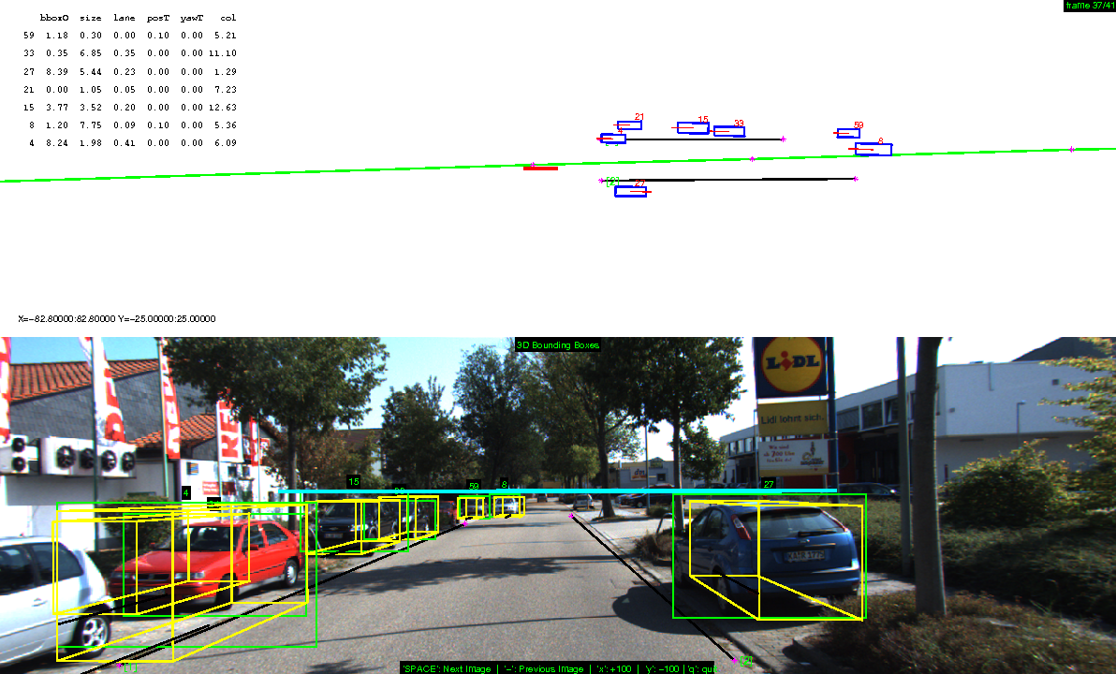
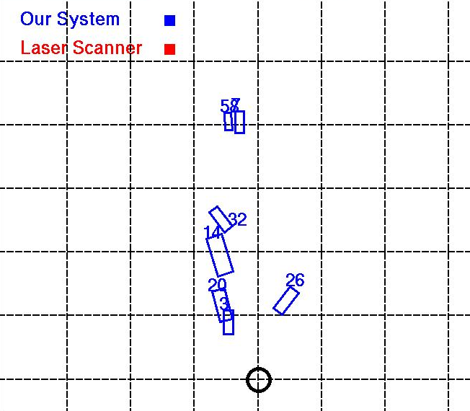
Effect of Lane Energy
After
Before

Slide 21
TP-TP Relation: Bounding Box Visibility
Occluded edge
Unoccluded edge
Determine 3D bounding boxes aware of occlusions due to objects in front
Encourage alignment for unoccluded edges
Relax alignment for occluded edges.

Slide 22
TP-TP Relation: Bounding Box Visibility
Visible fraction
of edge length
Visible fraction
of triangle area
Visibility fraction for a hypothesized bounding box edge:
Bounding box energy with occlusion:

Slide 23
TP-TP Relation: Bounding Box Visibility
Visibility fraction for a hypothesized bounding box edge:
Bounding box energy with occlusion:

Slide 24
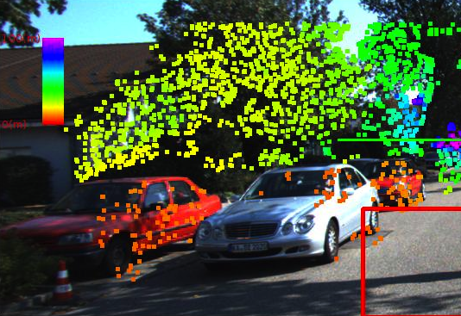
TP-TP: Probabilistic Occlusion
Determine soft assignment of 2D point tracks to each 3D bounding box
Probabilistic visibility for each point track.

Slide 25
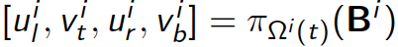
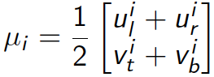
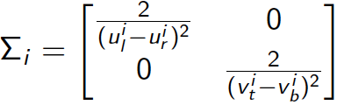
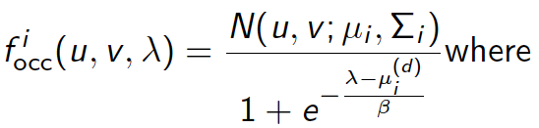
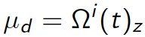
TP-TP: Probabilistic Occlusion
Represent TPs as
translucent 3D ellipsoids
Surface = Reflection (3D Point)
Volume = Transmission
= 1 - Occlusion
Projection of bounding box in image:
Mean and covariance of ellipsoid:
Model occlusion as a continuous soft probability:

Slide 26
TP-TP: Probabilistic Occlusion
Represent TPs as
translucent 3D ellipsoids
Surface = Reflection (3D Point)
Volume = Transmission
= 1 - Occlusion
P_{reflection}
P_{transmission}
depth
depth
Association probability for point j with object i :

Slide 27
TP-TP: Probabilistic Occlusion
Represent TPs as
translucent 3D ellipsoids
Surface = Reflection (3D Point)
Volume = Transmission
= 1 - Occlusion
depth
Association probability for point j with object i :

Slide 28
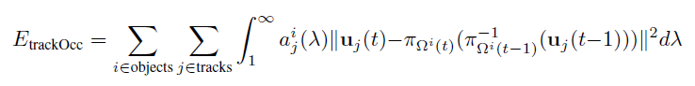
TP-TP: Probabilistic Occlusion
Represent TPs as
translucent 3D ellipsoids
Surface = Reflection (3D Point)
Volume = Transmission
= 1 - Occlusion
depth
Point track energy considering TP-TP occlusions:

Slide 29
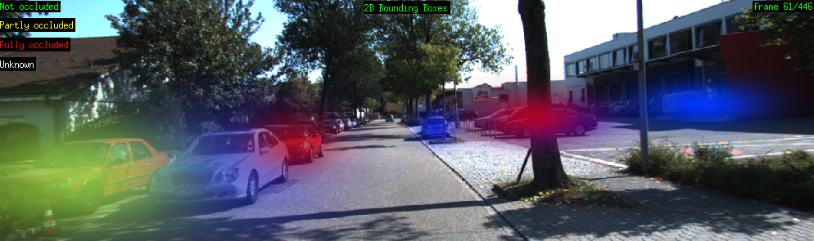
Probabilistic Occlusion Levels
Not occluded
Partly occluded
Mostly occluded
Probabilistic specification of occlusion level for each object

Slide 30
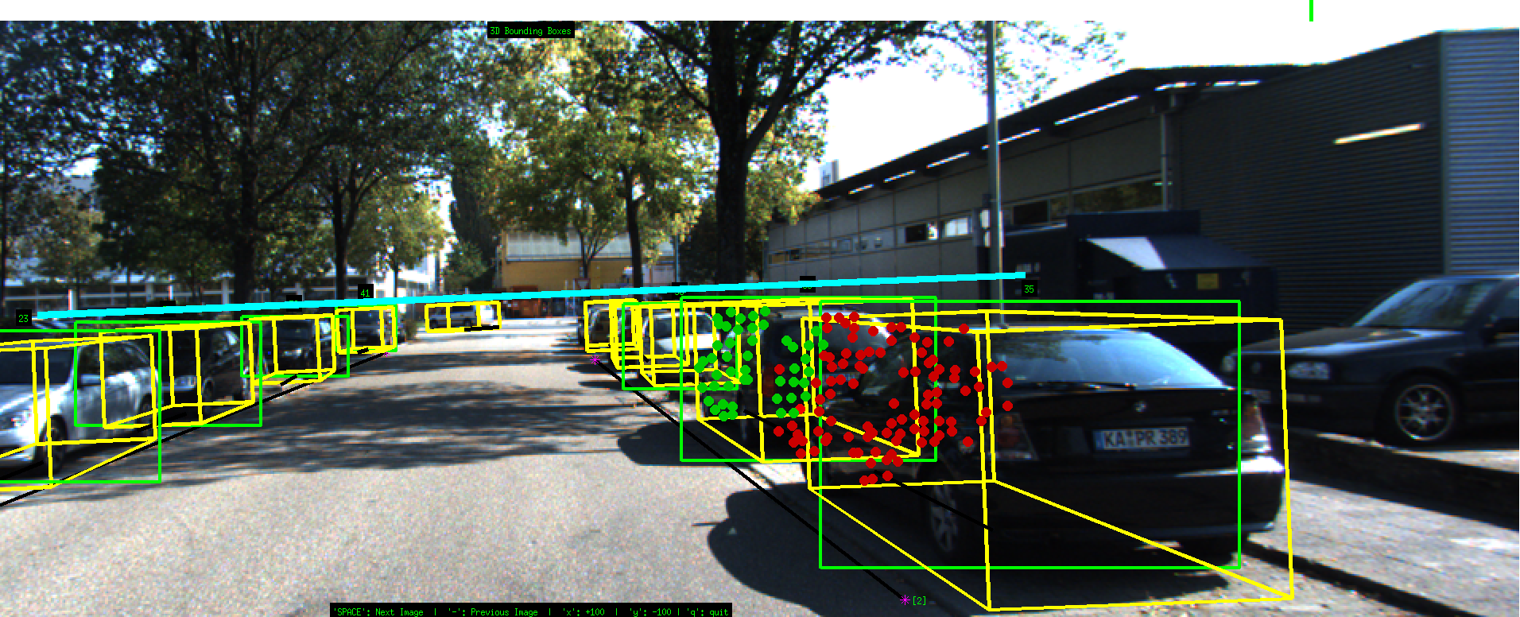
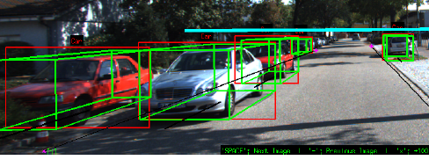

Effect of Occlusion Energy
Show point tracks assigned to correct object.

Slide 31
TP-TP Relationships: Collision
BEV Localization
Objects cannot physically occupy
the same 3D space.
Collision Resolution

Slide 32
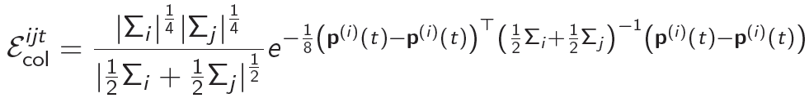
TP-TP Relationships: Collision
Bhattacharya coefficient for distance:
Has analytic form for Gaussian distributions.

Slide 33
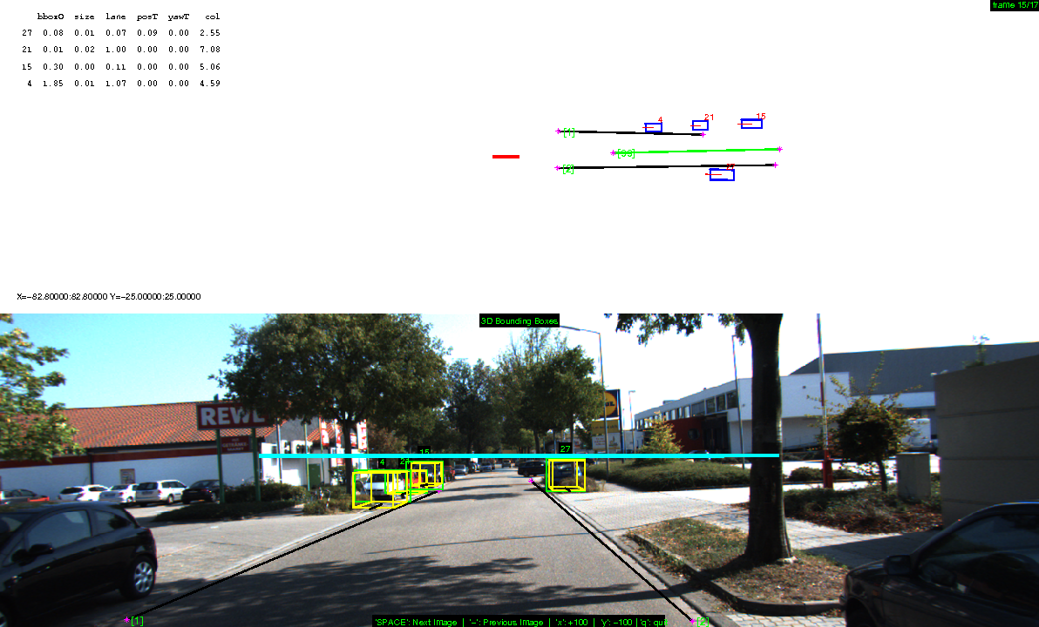
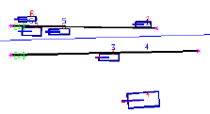
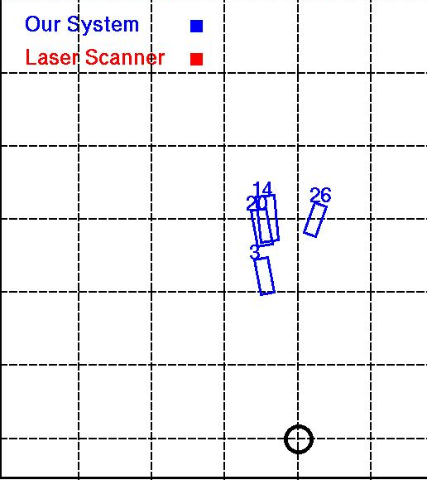
Effect of Collision Energy
Before
After

Slide 34
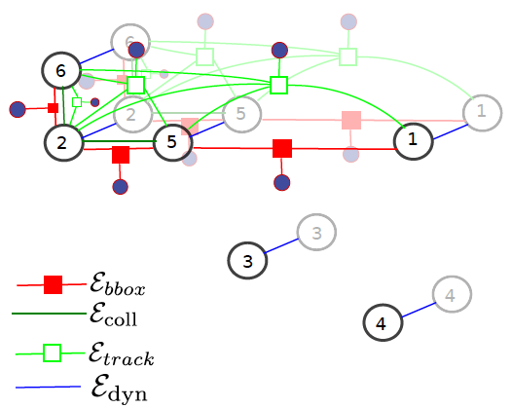
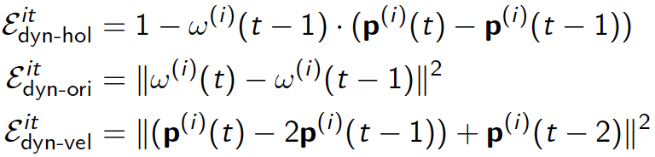
Temporal Consistency
Dynamic terms
holonomic, orientation and velocity constraints.
Car moves only in
forward direction
Smoothness for orientation
Constant velocity

Slide 35
Inference
Just use unconstrained minimization for now
Alternatingly minimize for a few iterations:
Lane + Dynamic energies
Bounding box + Size energies
Occlusion + Collision energies
Future work:
Message passing to exploit graph structure.

Slide 36
Results
Dataset : sequences from KITTI
Metrics :
Translation error
Orientation error (yaw angle along ground plane)
Size error (averaged over length, width and height)
Position error in Z (depth)
Position error in X (lateral)

Slide 37
Results
 | Translation (%) | Yaw (Degrees) | Size (%) | Z (%) | X (%)
Independent Localization | 8.210 | 19.824 | 1.209 | 7.922 | 1.469
Bounding Box + Lane | 7.761 | 4.787 | 1.283 | 7.358 | 1.689
Bounding Box + Lane + Dynamic | 7.704 | 4.635 | 1.264 | 7.294 | 1.660
Occlusion + Lane + Dynamic | 7.697 | 4.764 | 1.264 | 7.285 | 1.661
Occlusion + Lane + Dynamic + Collision | 7.802 | 4.655 | 1.259 | 7.362 | 1.727
Errors decrease using scene and TP constraints
Scene elements constrain object orientation (yaw)
Also better translation and depth errors

Slide 38
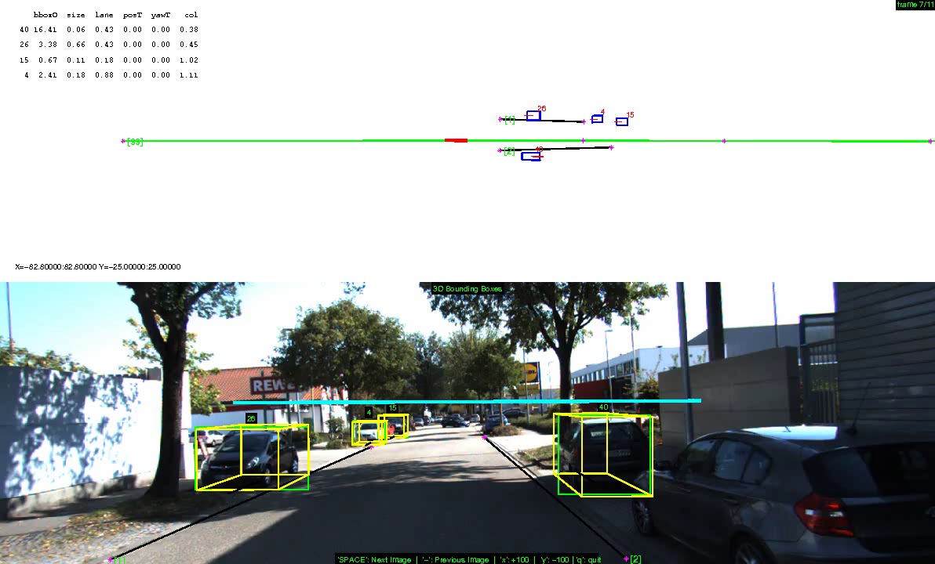
Videos

Slide 39
Conclusions
TP-Scene interactions lead to better localization
Significant improvement in orientation accuracy
Modeling TP-TP interactions lends consistency
Probabilistically reason about occlusions
3D object localization incorporating visibility
Soft point track associations to handle occlusions
Resolve collisions
Better accuracy than independent localization
For “important” metrics (depth and orientation)
Probabilistic notion of TP-Scene and TP-TP interactions
Forms input to scene recognition applications.

Slide 40
Future Work
Learning the weights
Better optimization
More extensive evaluation.

Slide 41
Existing 3D Localization
Have a figure here to explain:
The drawback of the existing solution, which localizes each TP individually.

Slide 42
Desired 3D Localization
Have a figure here to explain:
Better localization can be achieved using our method.

Slide 43
TP-TP Relationships: Occlusion
Occlusion modeling
How occlusion is handled in point tracks energy
Need occlusion translucency visualization
How occlusion is handled in bounding box energy
Need figure to explain

